Slide 1
Welcome to R/Medicine 101: Intro to R for Clinicians
Stephan Kadauke
R/Medicine 2020
Notes:
*

Slide 2
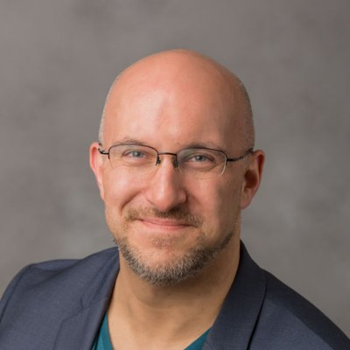
Stephan
Notes:
Chair of R/Medicine 2020 Organizing Committee and am leading this workshop. I am an Assistant Professor of Pathology and Laboratory Medicine at the Children’s Hospital of Philadelphia.

Slide 3

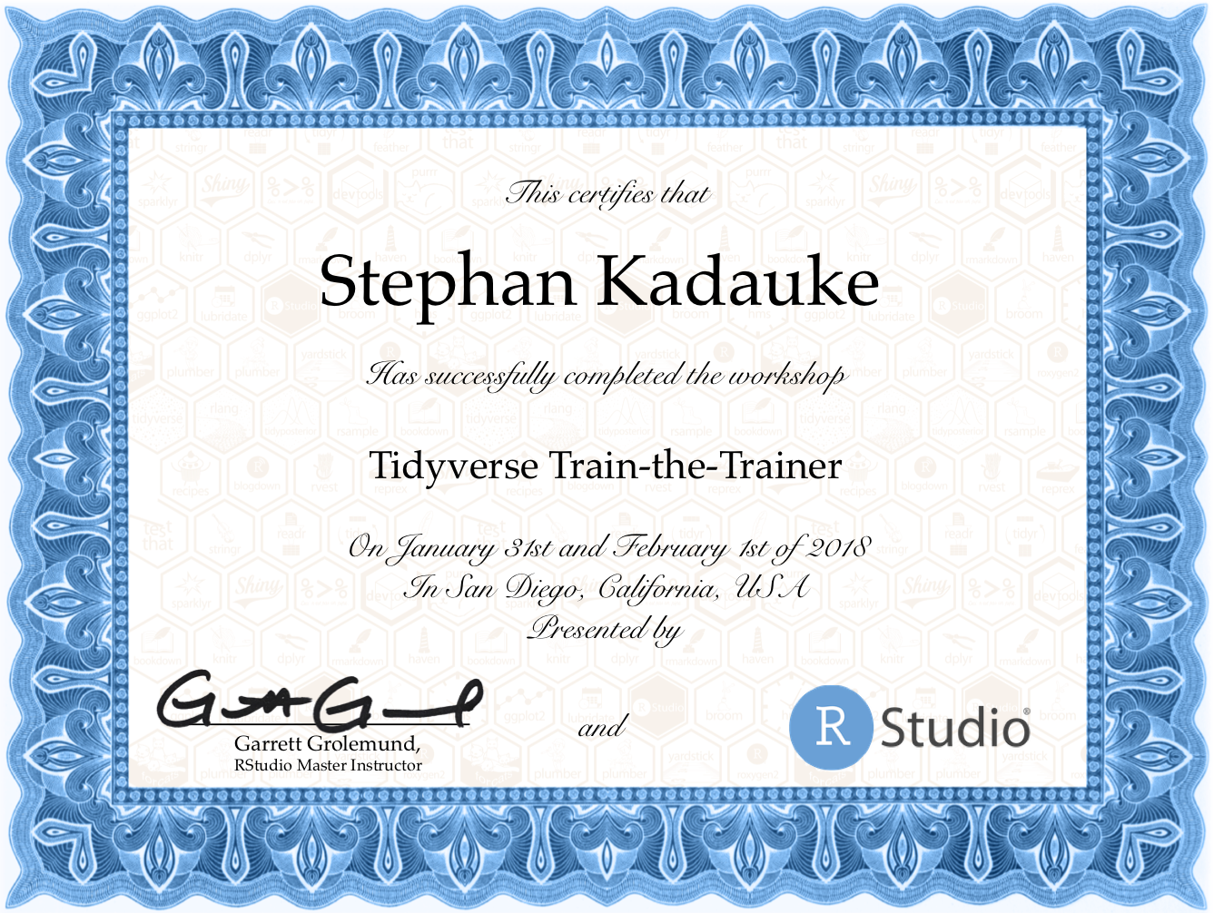
Notes:
I’ve been coding in R for 10+ years, and I’m an RStudio Certified trainer. I have taught R to physicians and other healthcare workers at the Harvard Massachusetts General Hospital, at the University of Pennsylvania, and at various conferences, both online and offline.

Slide 4
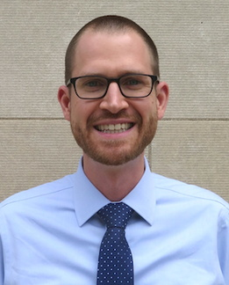
Joe
Notes:
I am joined today by two co-instructors. Joe Rudolf is an Assistant Professor of Pathology at the University of Utah.

Slide 5
Amrom
Notes:
And Amrom Obstfeld. Amrom is an Assistant Professor of Pathology and Laboratory Medicine at the Children’s Hospital of Philadelphia.

Slide 6
Introducing the TAs!
Daniella Mark
Mohamed El Fodil Ihaddaden
Silvia Canelon
Shelmith Kariuki
Sina Rüeger
Amit Kohli
Richard Hanna
Shannon Hagerty
Martin Frigaard
Daniel Chen
Cass Wilkinson Saldaña
Peter Higgins
Bárbara Bitarello
Paul Wildenhain
Jake Riley
Amy Goodwin Davies
Zach Dravis
Notes:
We’re fortunate to have a large number of TAs to help with the course.

Slide 7
Orientation to the Technology

Slide 8

Main session vs Breakout rooms
Webinar-style
100+ participants
Mic off
Camera off
Meeting-style
10-15 participants / room
Mic on
Camera optional

Slide 9
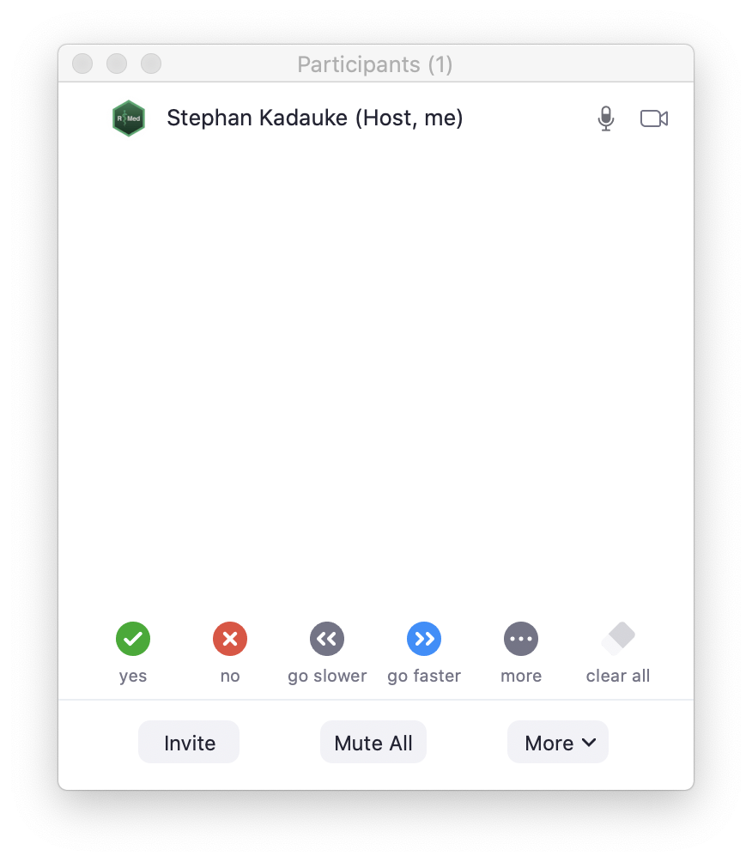
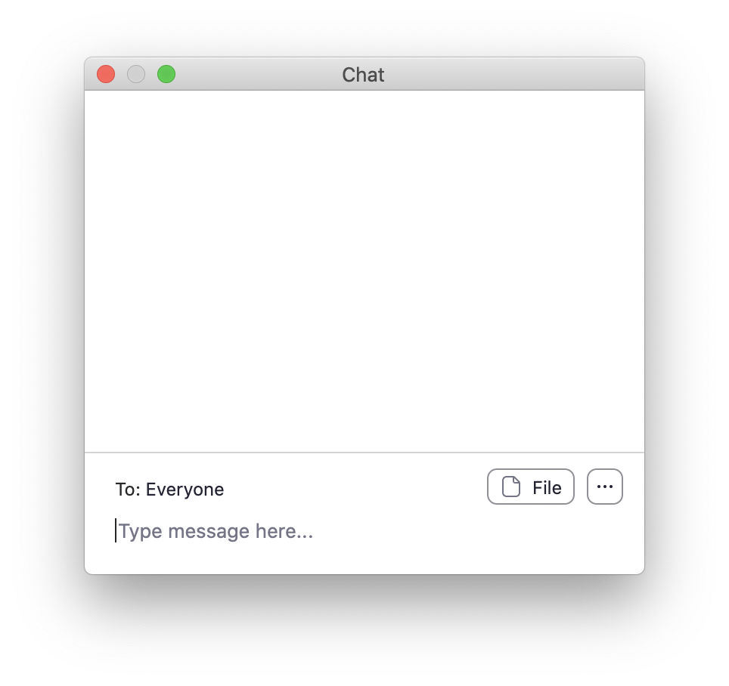

Slide 10
Non-verbal feedback

Slide 11
Chat window
Notes:
Ask for help here! Briefly describe the problem you have, and your TA will try to help you resolve it.

Slide 12
Your Turn #1
Click the “yes” button in the Participants window.
Then write your location (city, country) in the Chat window.

Slide 13
Orientation to the Course

Slide 14
The Data Analysis Pipeline

Slide 15
Lecture slides

Slide 16
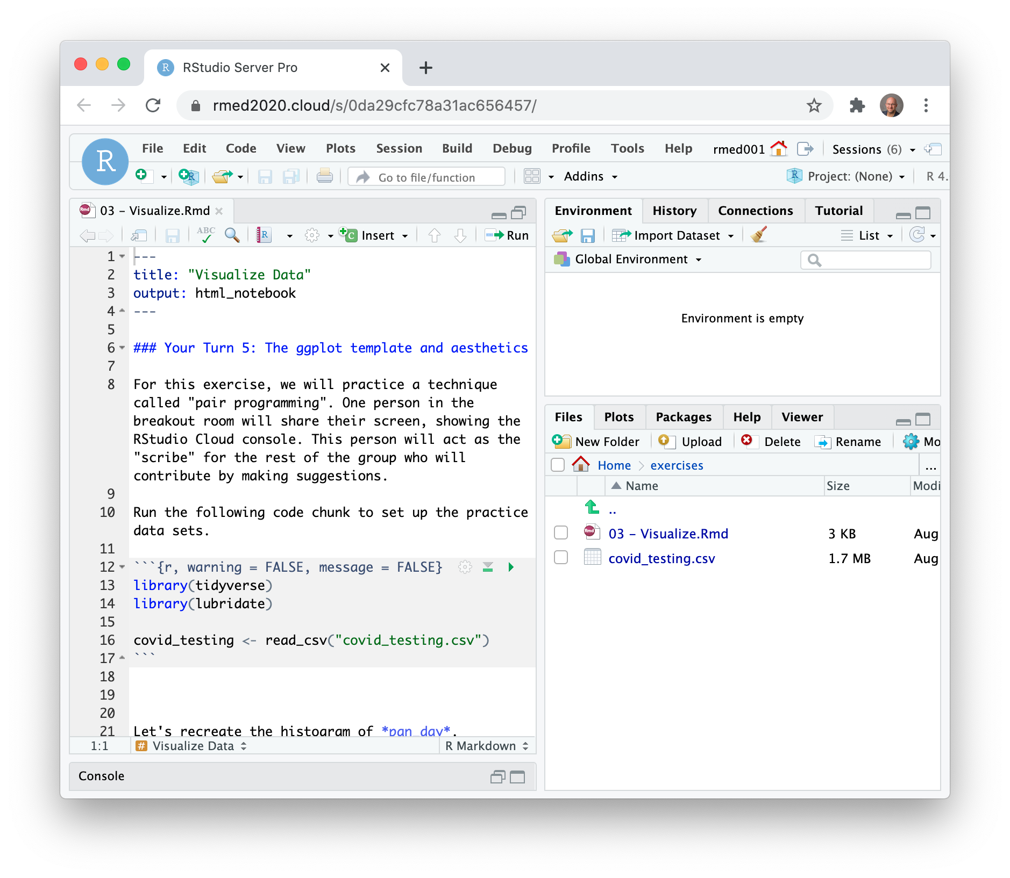
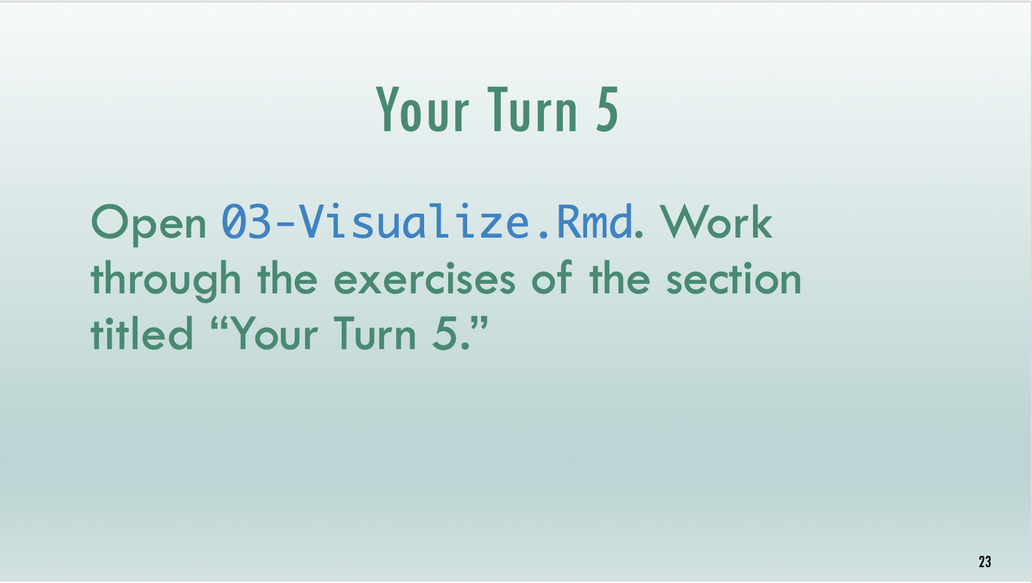
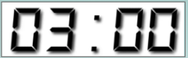
Timed interactive coding exercises

Slide 17
Code of Conduct
Screenshots,
Recordings,
Photographs
Harassment
https://events.linuxfoundation.org/r-medicine/attend/code-of-conduct/
Notes:
We want to provide a welcoming and supportive environment for all people, regardless of background or identity.
** No harassment: includes abusive, offensive or degrading language, unwelcome sexual advances, in writing or voice
** for full CoC see https://events.linuxfoundation.org/r-medicine/attend/code-of-conduct/
** Also, to respect the privacy of participants, we don’t allow screenshots, recordings, or photographs.
If we find that you violate the code of conduct you may be removed from the course.

Slide 18
Your Turn #2
Meet and greet! We will send you into breakout rooms, where you will have 10 minutes to meet your TA and 10-15 of your fellow participants.
Notes:
TAs will start by introducing themselves, and then “pass the baton” to the next person, who will then also “pass the baton” to the next person, and so on.
For this exercise, we encourage you to turn on your microphone and camera, if you’re comfortable.
At the 10 min mark, we’ll bring everyone back into the main session.

Slide 19
End of slides

Slide 20
Your Turn #1
Use green Tw Cen MT 44 for text
Use blue Monaco 36 for code
Be explicit about mode of feedback (e.g.: Click “yes” when you are finished.)
To pick a timer, click Home > Layout > select the desired slide layout.

